Slide 1
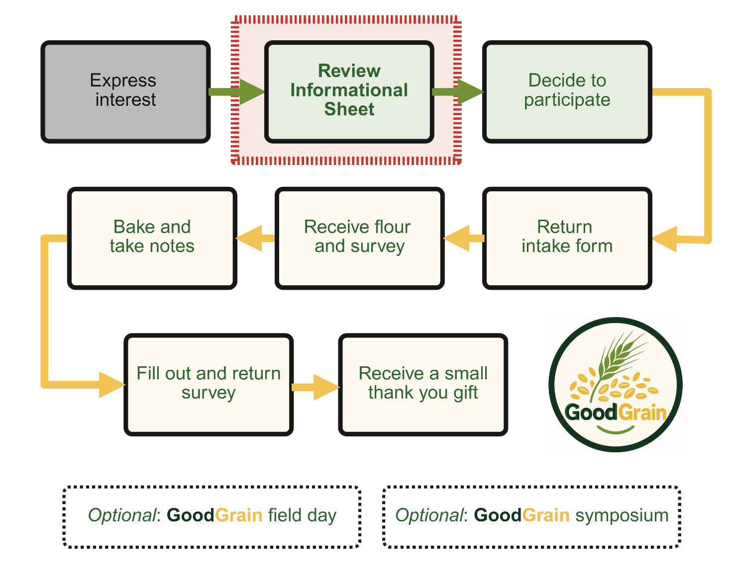
GoodGrain Home Baking Evaluation
For the Curious
GoodGrain Home Baking Evaluation

Slide 2
Two videos in this series
Informational video
For the curious video (this one)
The same information is also available in the Informational Sheet
GoodGrain Home Baking Evaluation

Slide 3
Perennials versus annuals
GoodGrain Home Baking Evaluation

Slide 4
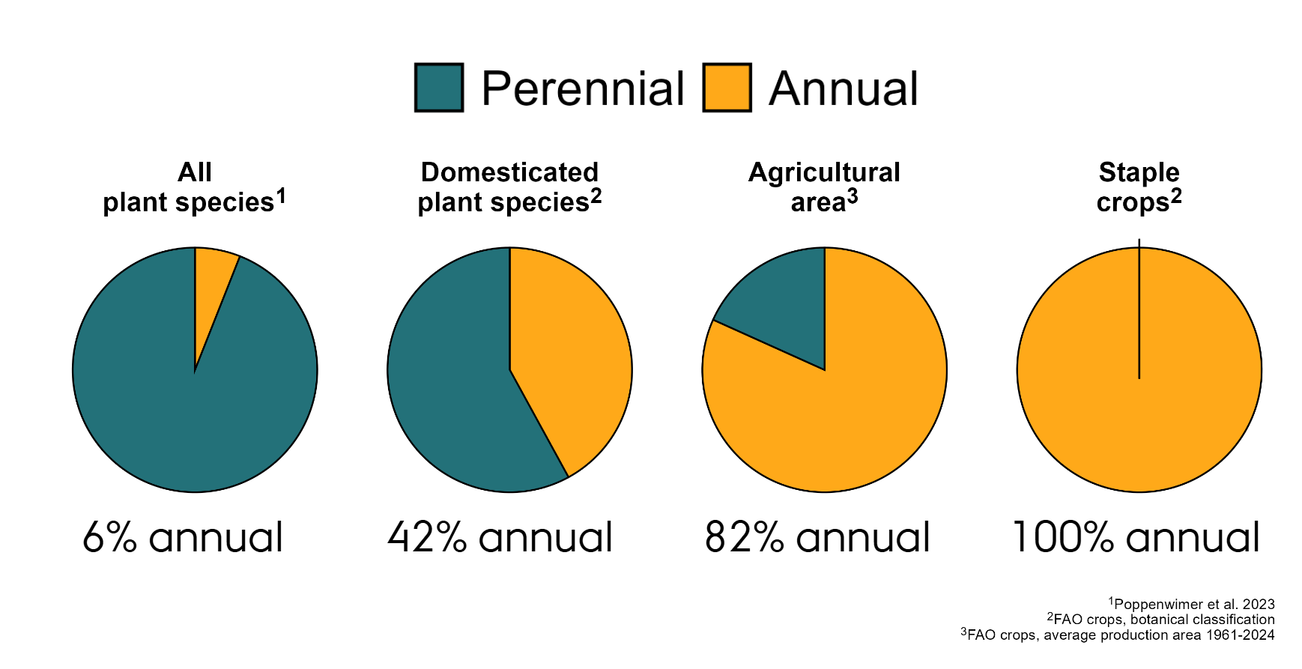

Slide 9
Why might perennial grains be useful?
GoodGrain Home Baking Evaluation

Slide 10
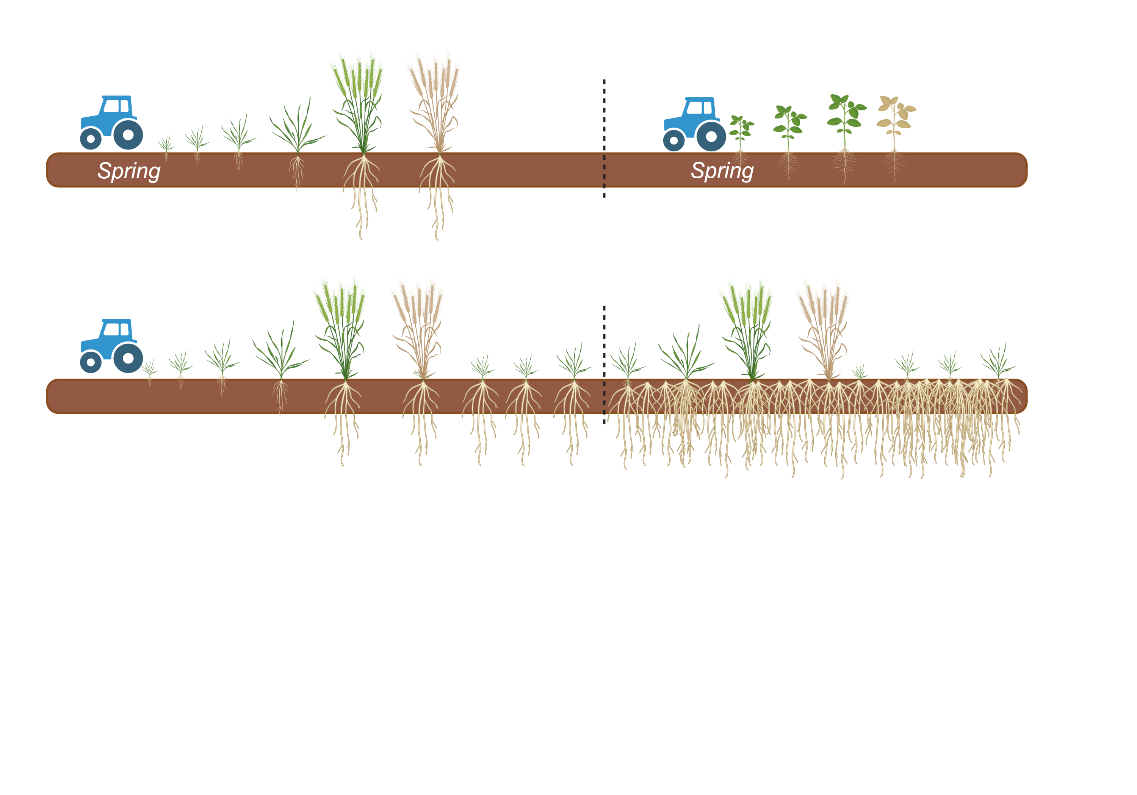
Annual grains
Perennial grains
GoodGrain Home Baking Evaluation

Slide 11
















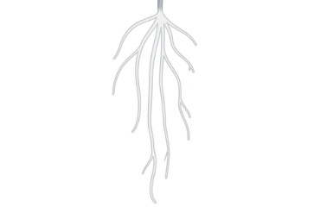
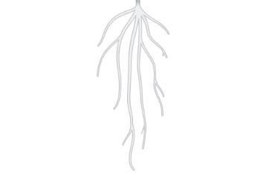











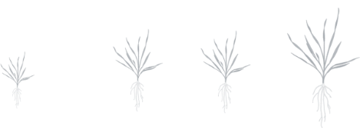








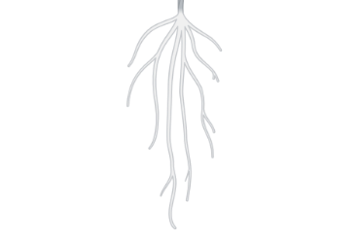
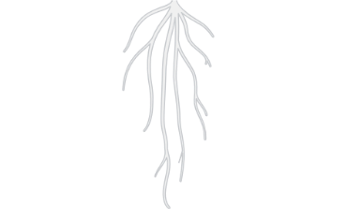
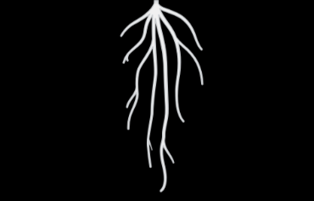
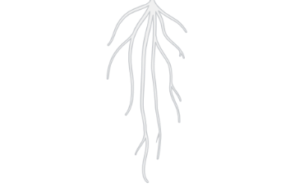
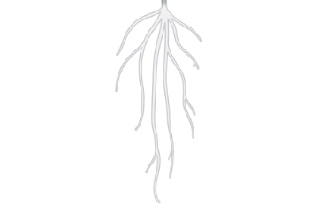
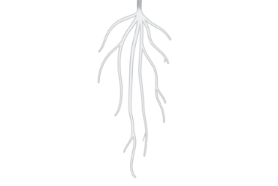
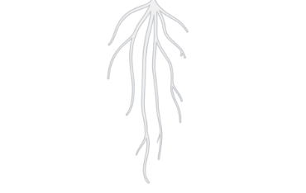
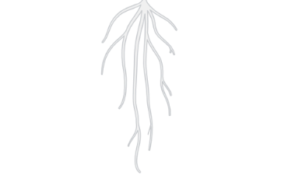
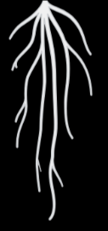
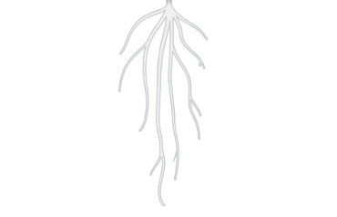
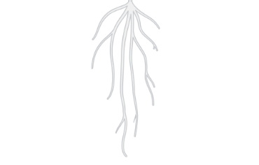
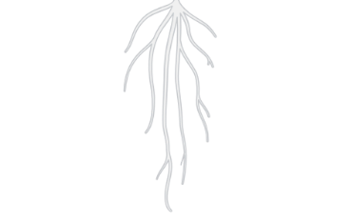
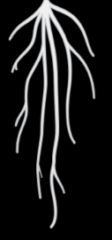
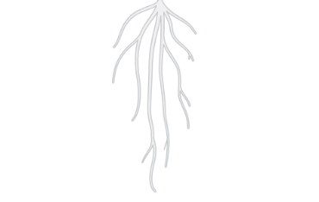
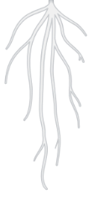
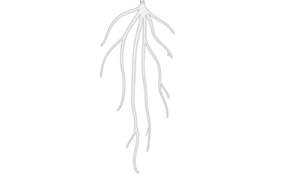
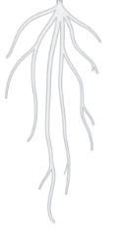
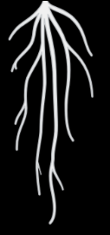
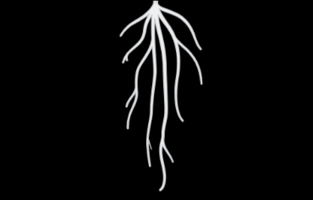
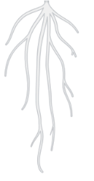
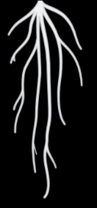
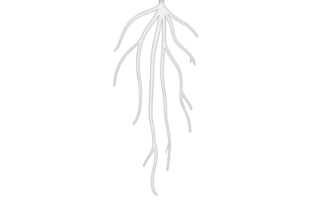
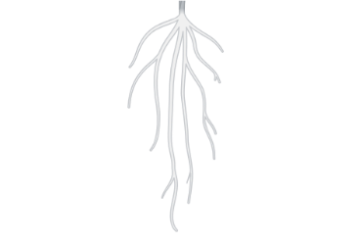
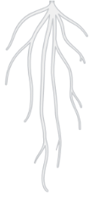

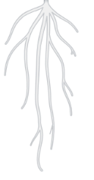
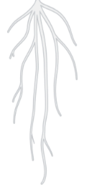
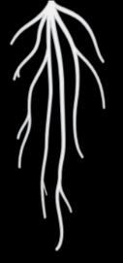
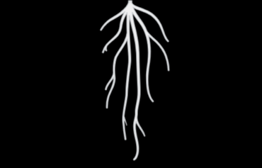
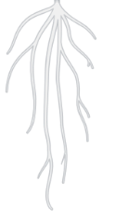
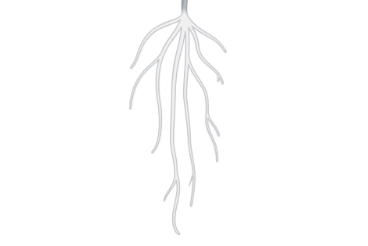
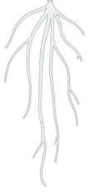
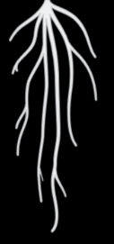
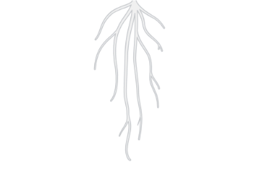
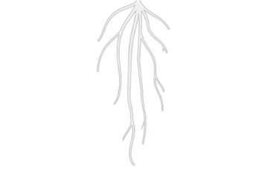
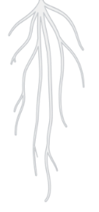

Annual grains
GHG
GHG
Labor, seed
Labor, seed
Soil erosion
Spring
Spring
Nitrate leaching
Perennial grains
GHG
Carbon sequestration
Labor, seed
Nitrate uptake
Soil biology
GoodGrain Home Baking Evaluation

Slide 12
What is the status of perennial grains?
GoodGrain Home Baking Evaluation

Slide 13
1930
1950
1970
1990
2010
2030

Slide 14
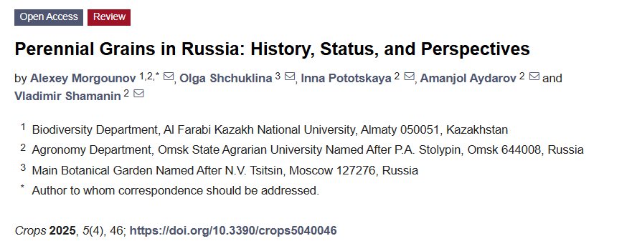
1930
1950
1970
1990
2010
2030

Slide 15
1930
1950
1970
1990
2010
2030

Slide 16
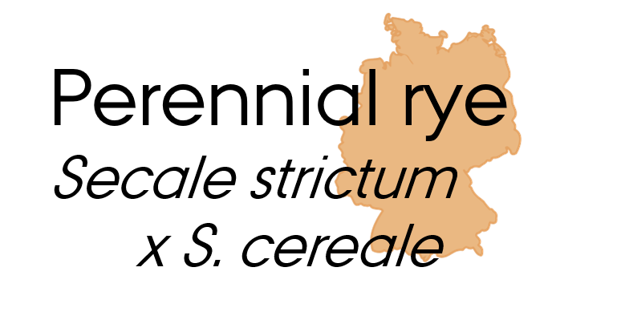


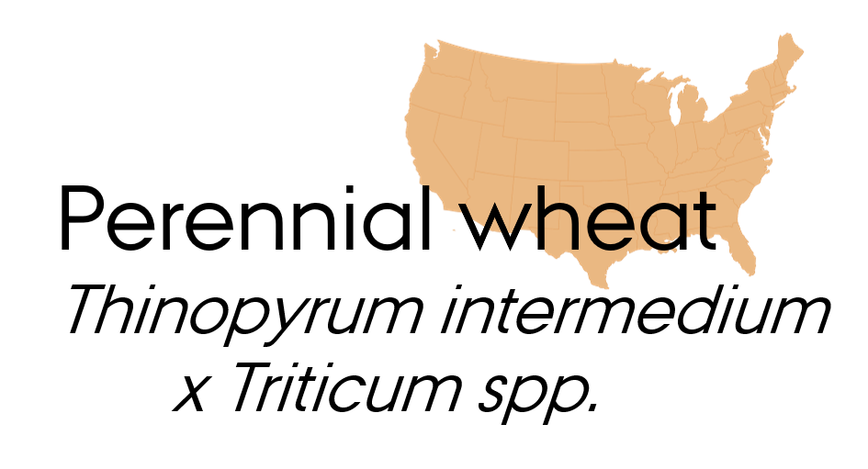
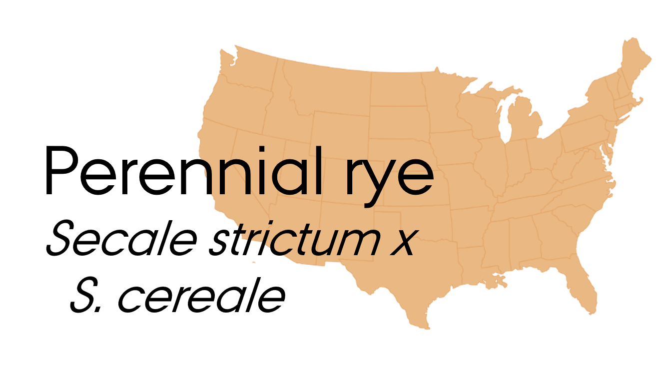
1930
1950
1970
1990
2010
2030

Slide 17
More about
GoodGrain’s perennial rye
GoodGrain Home Baking Evaluation

Slide 18
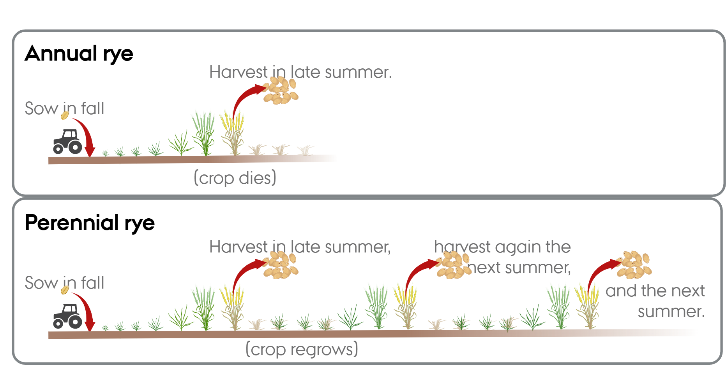
GoodGrain Home Baking Evaluation

Slide 19
GoodGrain Home Baking Evaluation

Slide 20
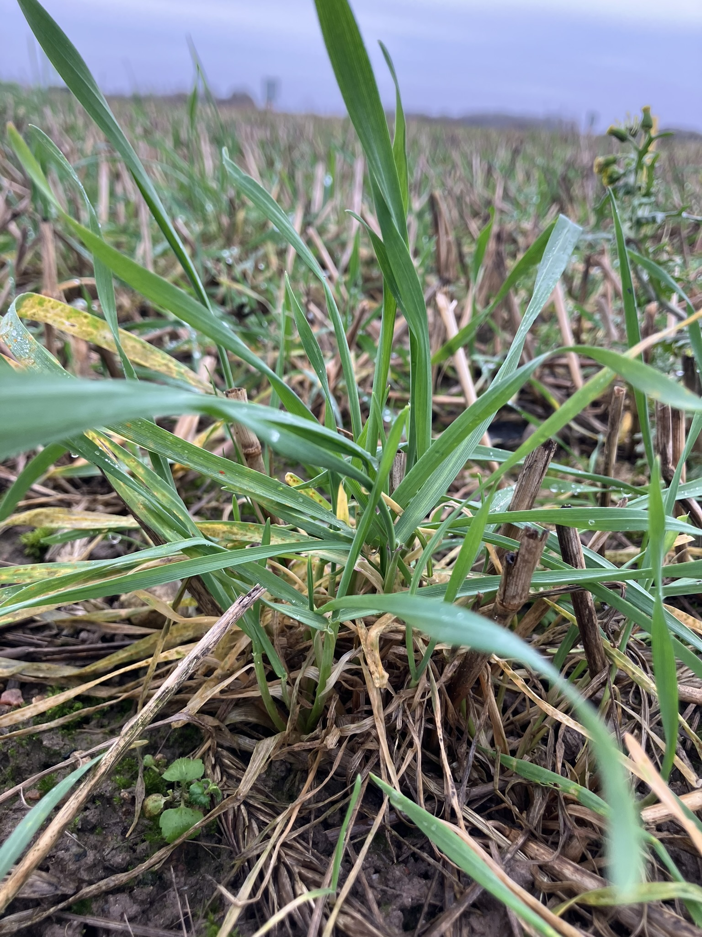
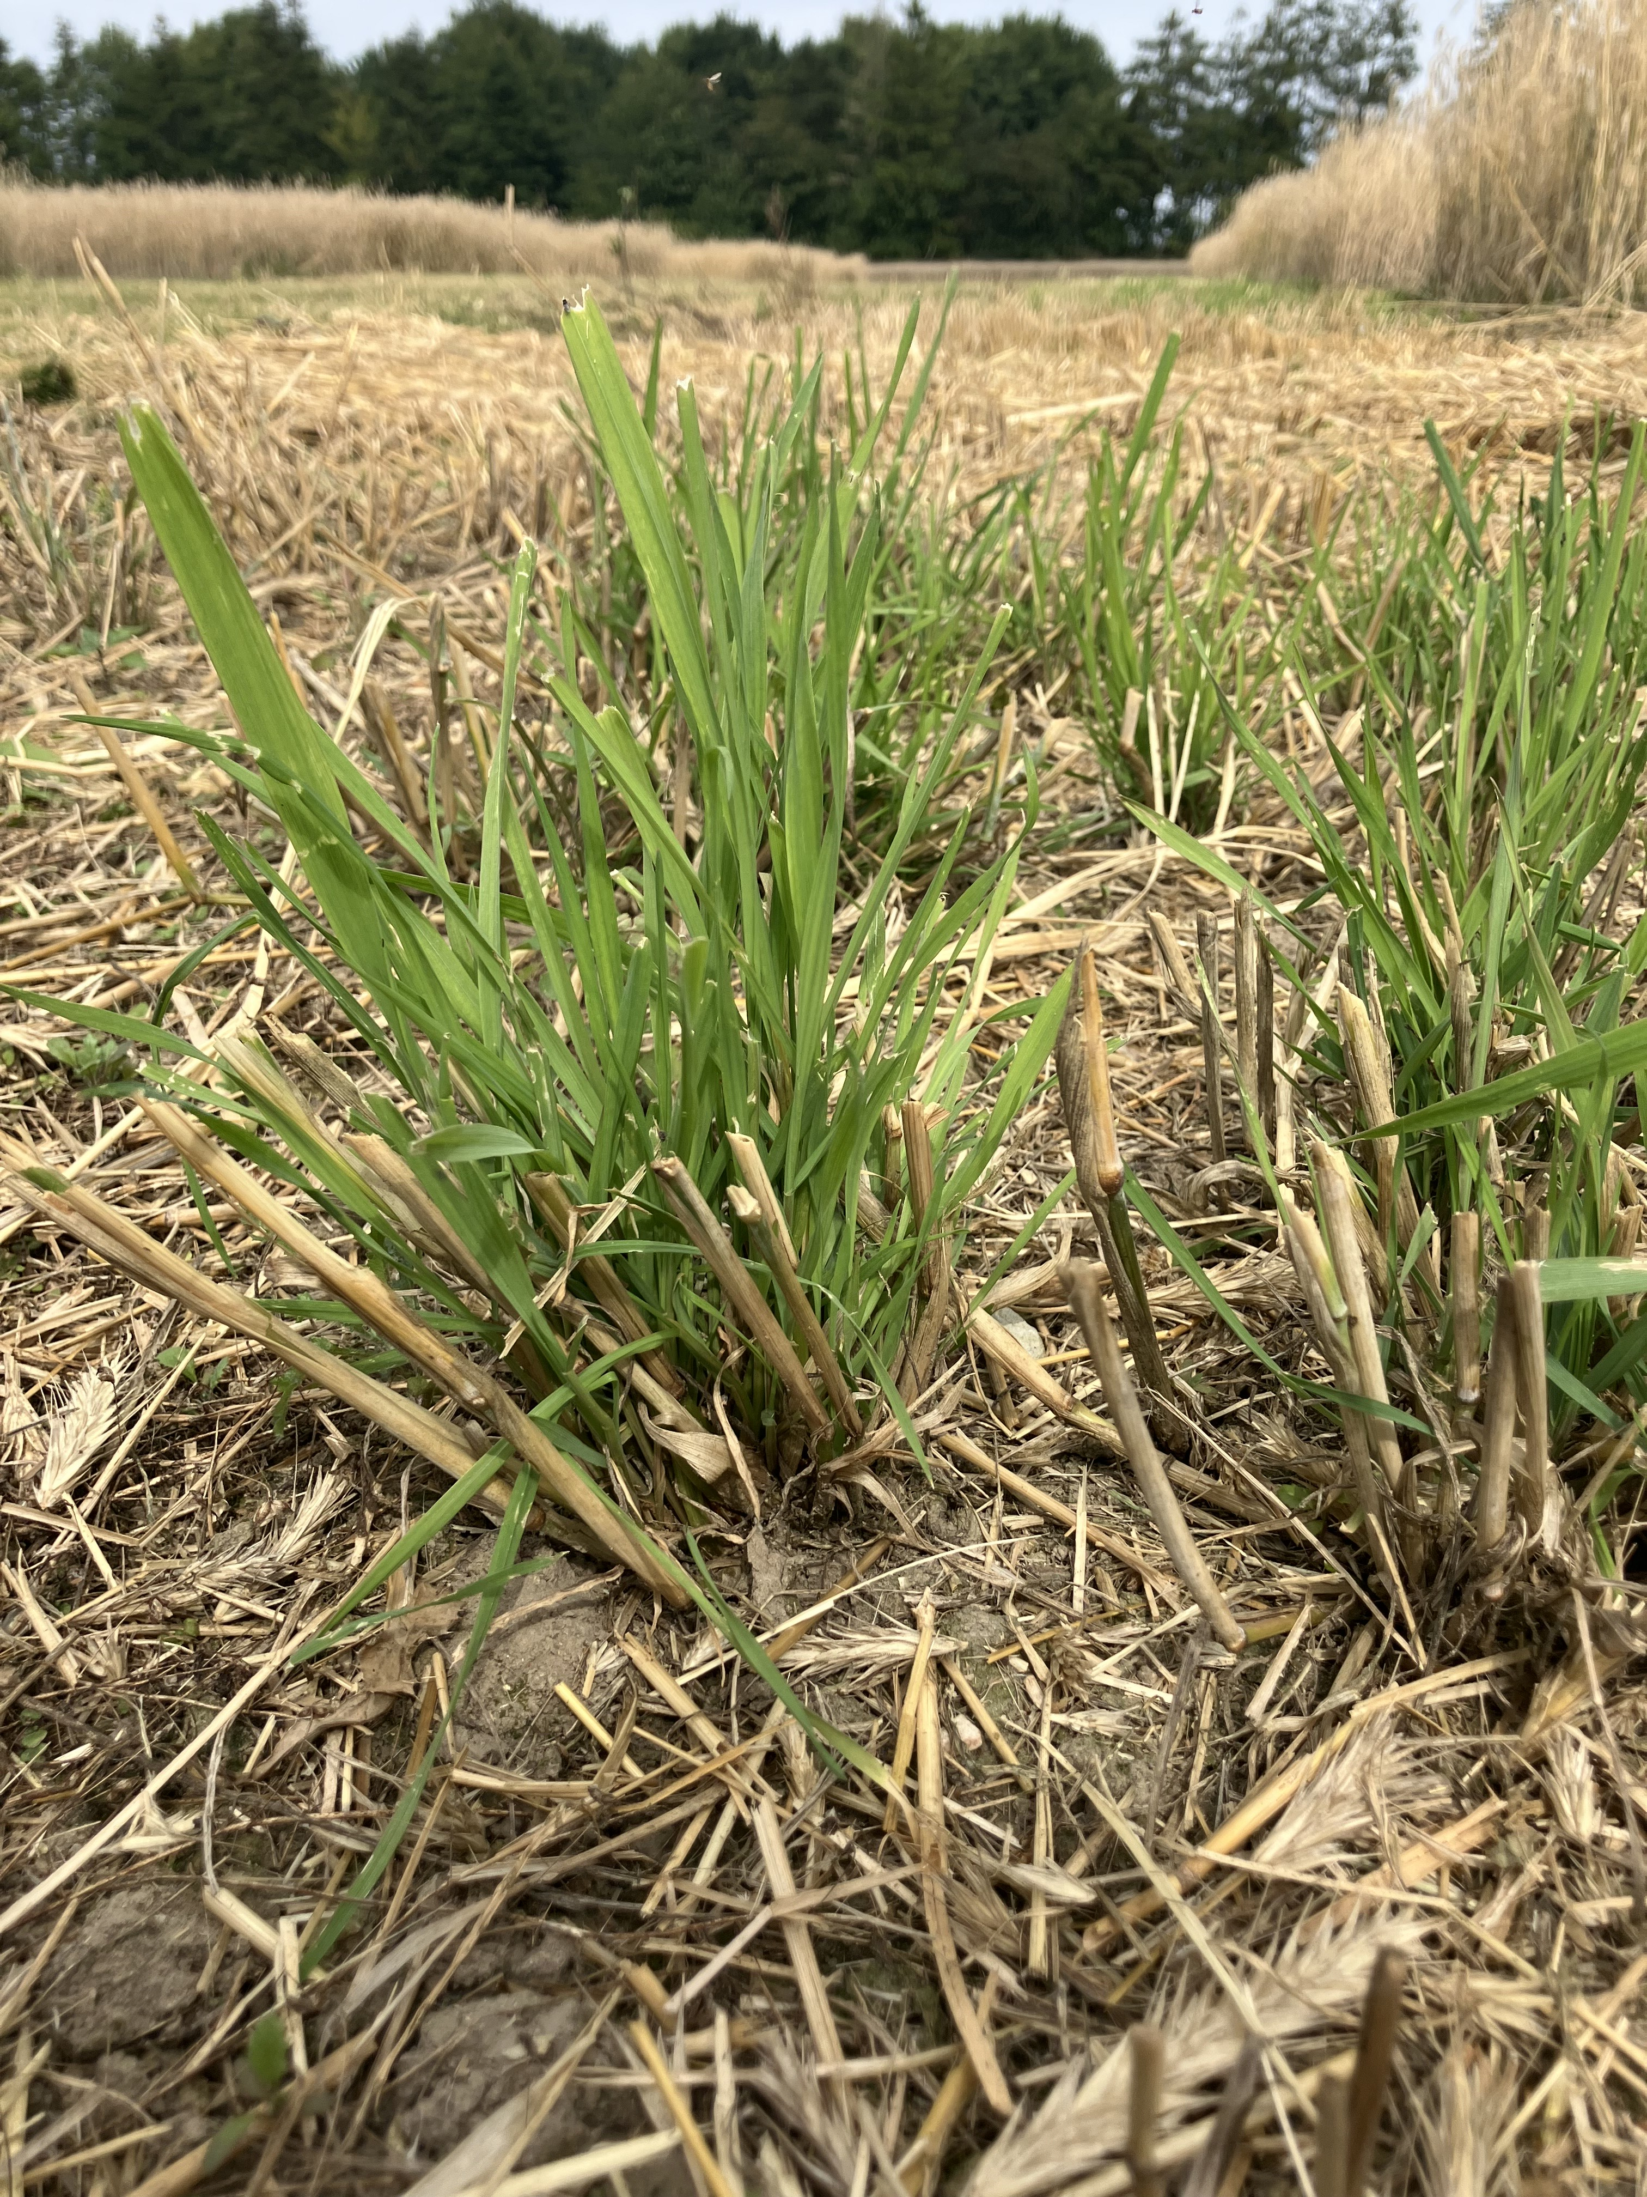
12 August 2025
12 October 2025

Slide 21
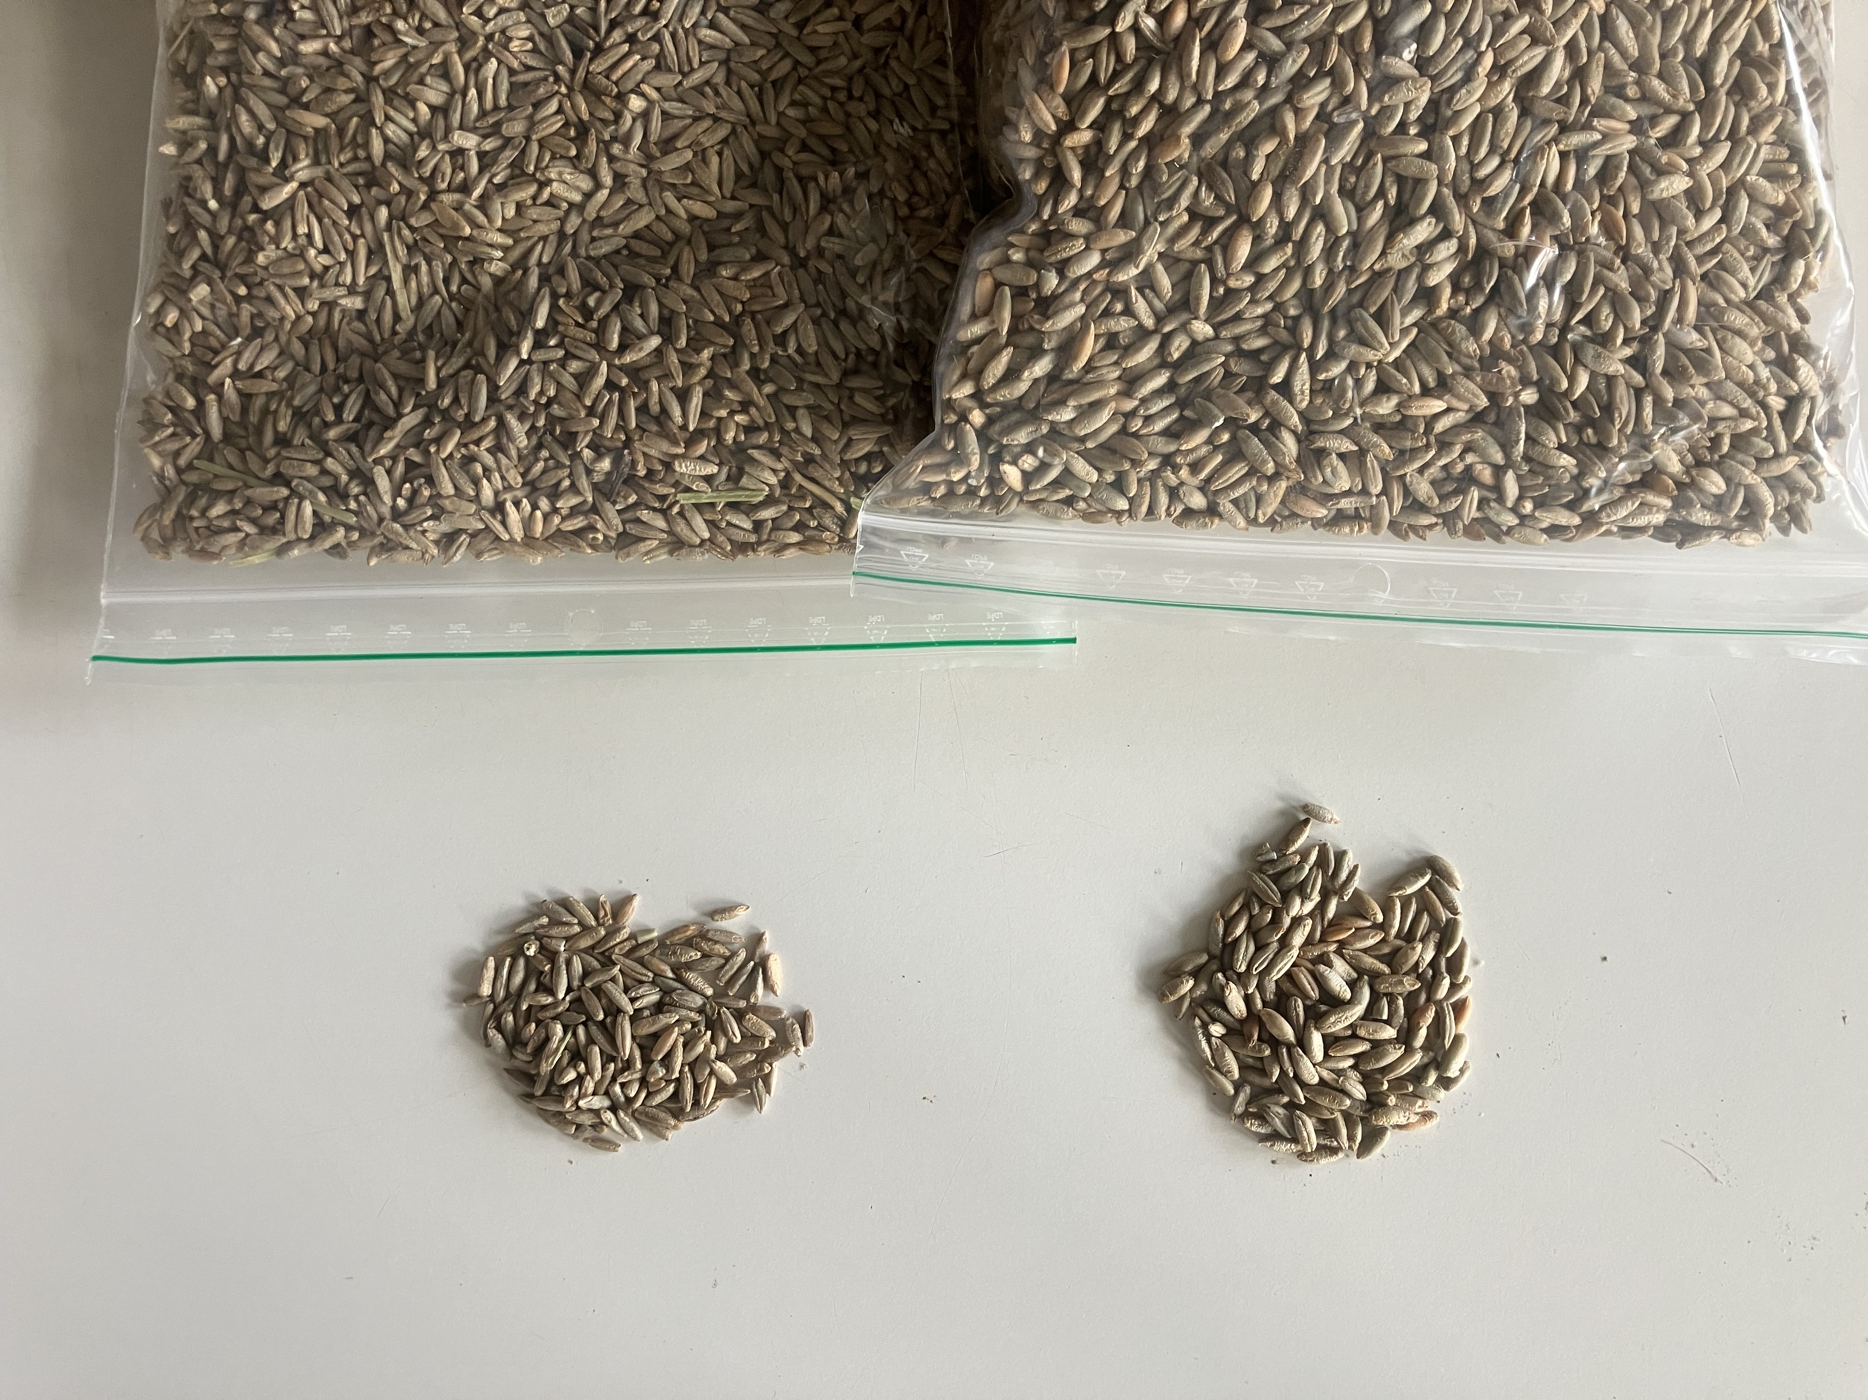
Perennial rye grain
Annual rye grain

Slide 22
Perennial rye grain
Annual rye grain

Slide 23




Funding and project partners
This citizen science project is part of an NNF Plant2Food research project (Grant #NNF22SA0081019).
Aarhus University: Department of Agroecology and Department of Food Science
Wageningen University and Research, Netherlands
Meyers, a Danish food enterprise
More information: projects.au.dk/plant2food/funded-projects/goodgrain
GoodGrain Home Baking Evaluation

Slide 24
Thank you!
GoodGrain Home Baking Evaluation

